Slide 1
Optimality Bounds for Recovering Geometric Information in Images
By Brady Sheehan, Duquesne University
Advised by Stacey Levine, Ph.D.
April 1st, 2016
Notes:
introduction

Slide 2
Outline
Motivation
Problem Formulation and Curvature Denoising
Framework for Bounding Natural Image Denoising
Current Work: Adaptation to Curvature
Notes:
Big idea throughout the presentation is that there are multiple classes of denoising algorithms
One class of algorithms that is popular today is approaching optimality in the sense of how well they can denoise an image
This work will introduce another class of algorithms and propose a framework for determining if this class of algorithms could produce “better” denoising results

Slide 3
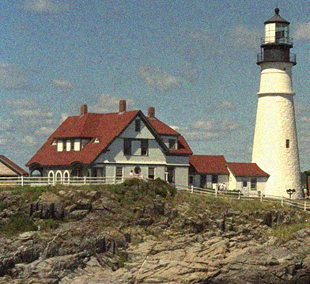


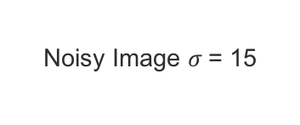
Motivation: State of the Art Denoising Methods
BM3D is a well-known, state of the art denoising algorithm (but it’s not perfect!)
Noisy Image $σ$= 15
Original image
BM3D Result
Images credit: http://r0k.us/graphics/kodak/ Algorithm credit: http://demo.ipol.im/demo/l_bm3d/
Notes:
How well can we currently denoise images?
BM3D is one algorithm in the class of algorithms that approach denoising by considering patches – its good.
It turns out that BM3D is about as close to as good as patch based denoising algorithms can get (in terms of mean square error)

Slide 4
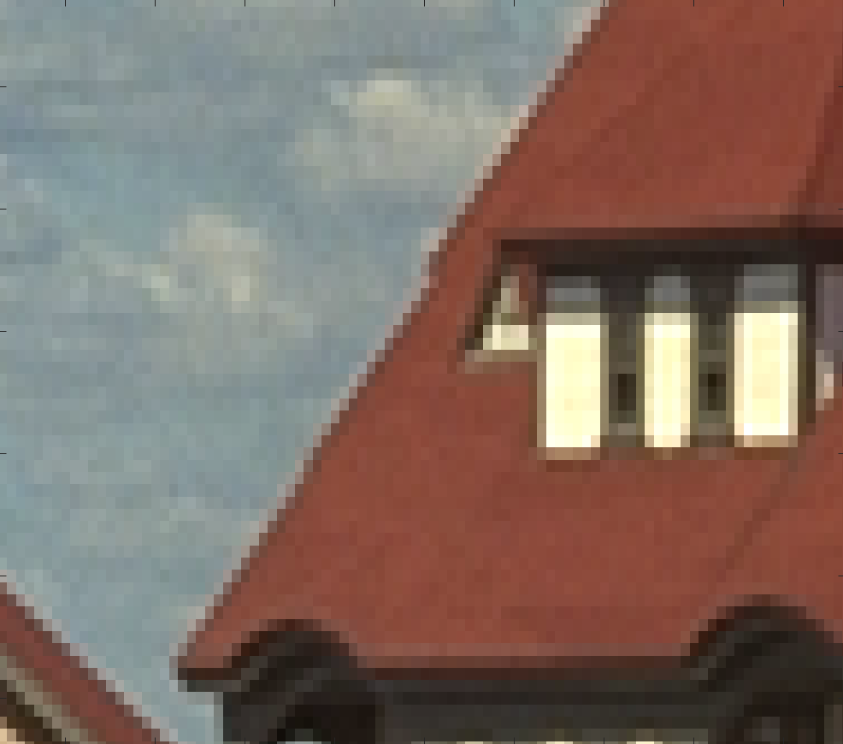
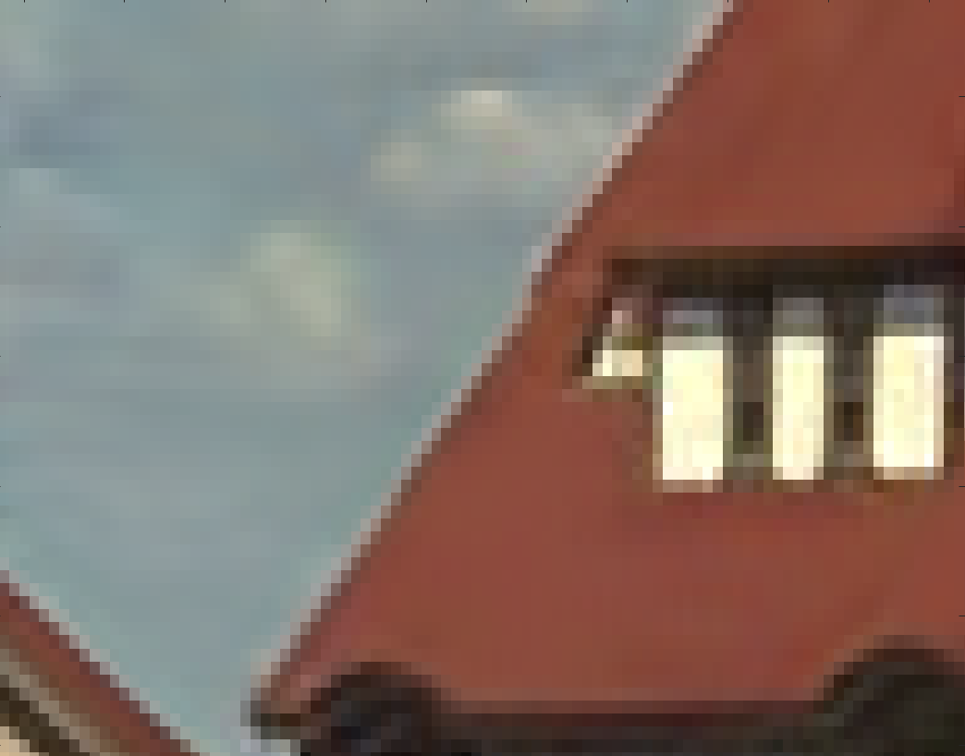
Motivation: State of the Art Denoising Methods
Original image
BM3D Result
Images credit: http://r0k.us/graphics/kodak/ Algorithm credit: http://demo.ipol.im/demo/l_bm3d/
Notes:
Here I blew up one section of the images from the previous slide.
Here you can notice that the image on the right is much smoother than the image on the left:
Clouds, edges, house

Slide 5
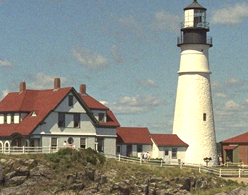

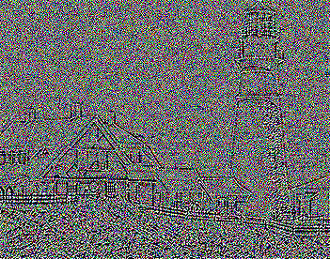
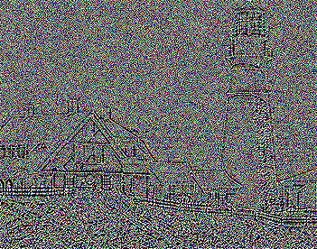
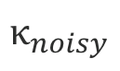
Motivation: How well can we denoise data?
Noisy
denoise
$$κ_{noisy}$$
Images credit: http://r0k.us/graphics/kodak/ Algorithm credit: http://demo.ipol.im/demo/l_bm3d/
Notes:
How well can we currently denoise images?
BM3D is one algorithm in the class of algorithms that approach denoising by considering patches – its good.
It turns out that BM3D is about as close to as good as patch based denoising algorithms can get (in terms of mean square error)

Slide 6
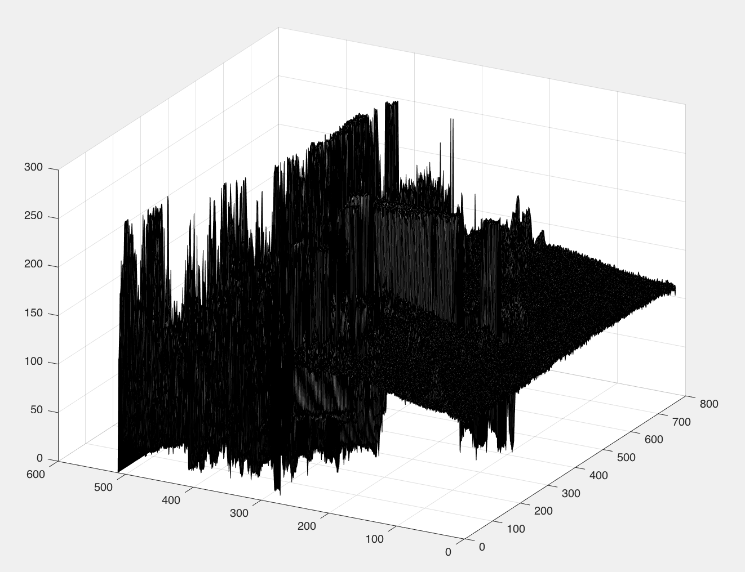
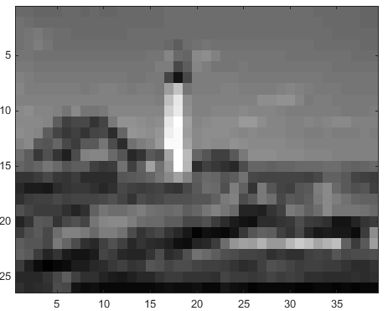
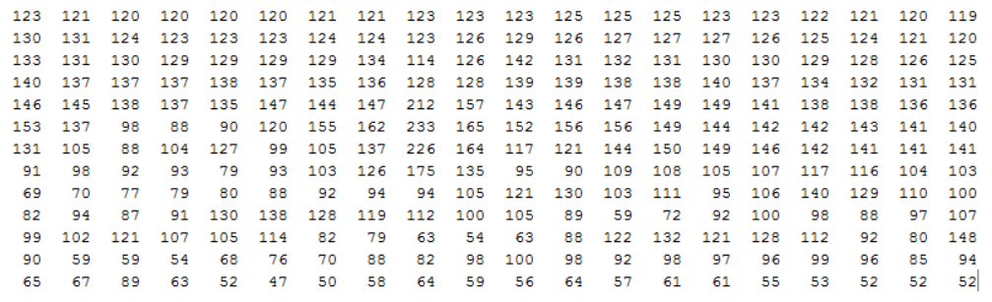

Representing an Image
Image: $y=f\left(i,j\right)$
$\left(i,j\right)$: pixel location
$f\left(i,j\right)$: intensity value at $\left(i,j\right)$
Notes:
Typically we like to think of an image as a function of two variables where at some location there is an intensity value and we represent this as a matrix
As we will see later, sometimes it is helpful to think about an image as a surface

Slide 7
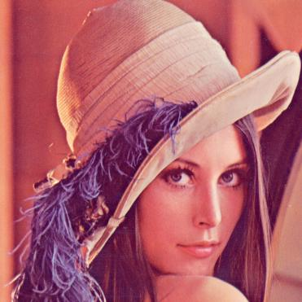

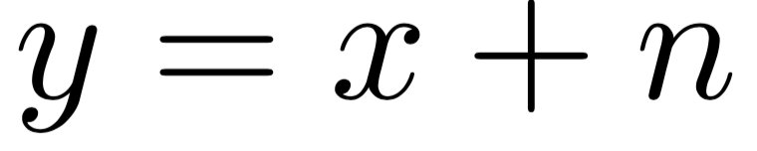
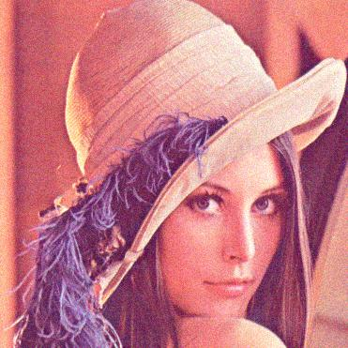
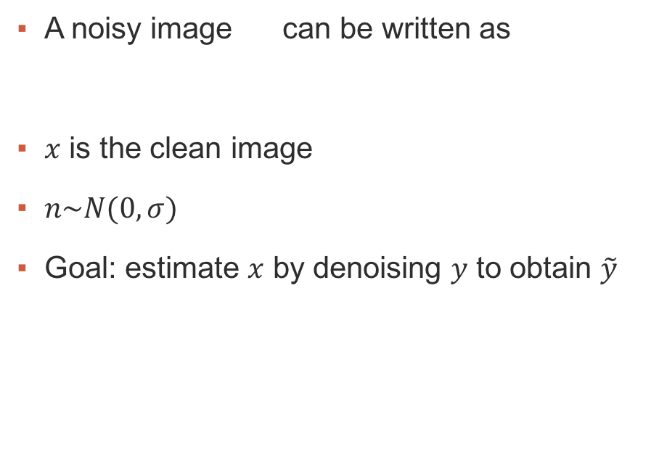
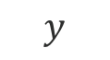
Problem Formulation
$$y$$
A noisy image can be written as
$x$ is the clean image
$n\sim N(0,σ)$
Goal: estimate $x$ by denoising $y$ to obtain $\tilde{y}$
Notes:
Normally we have some image that was corrupted by noise but don’t know exactly what the noise is.
However, we usually assume the noise is Gaussian and model a noisy image as y = x + n

Slide 8
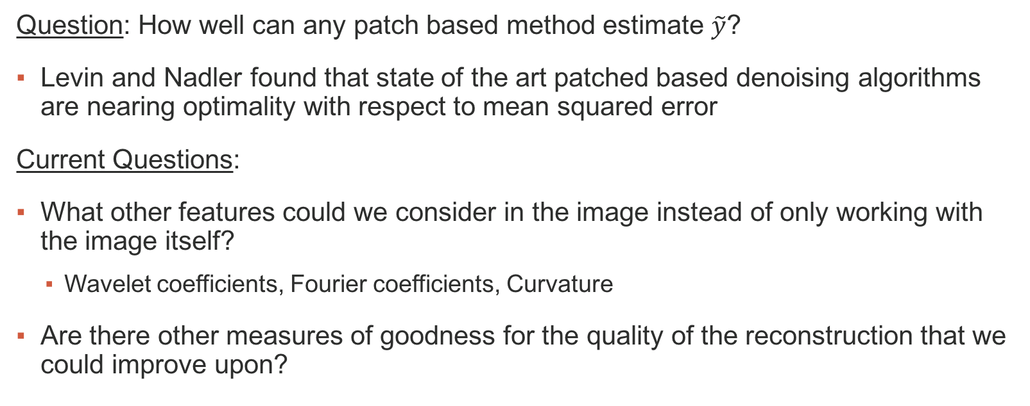
“Is Denoising Dead?”¹
Question: How well can any patch based method estimate $\tilde{y}$?
Levin and Nadler found that state of the art patched based denoising algorithms are nearing optimality with respect to mean squared error
Current Questions:
What other features could we consider in the image instead of only working with the image itself?
Wavelet coefficients, Fourier coefficients, Curvature
Are there other measures of goodness for the quality of the reconstruction that we could improve upon?
Notes:
We want to consider how well we can denoise an image with patched based methods.
A paper from 2010 was one of the first to consider bounds on image denoising and titled their paper “is Denoising dead?”, chatterjee and milanfar.
Then, Levin and nadler in 2011 found that patched based methods are nearing optimality in terms of the MSE (BM3D is one of the algorithms they compared with)
We want to know if we can do better. How do we do that? Well, we can consider other features of an image instead of just working with the image itself:
People process images in the wavelet domain or the Fourier domain considering coefficients
Here we will focus on curvature
In the future: consider other goodness measures

Slide 9
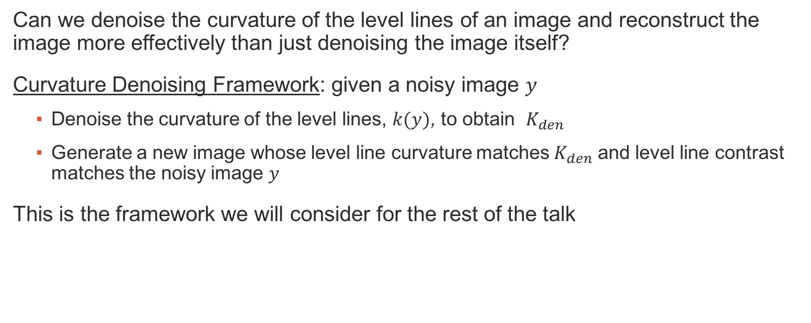
Image Curvature
Can we denoise the curvature of the level lines of an image and reconstruct the image more effectively than just denoising the image itself?
Curvature Denoising Framework: given a noisy image $y$
Denoise the curvature of the level lines, $k(y)$, to obtain $K_{den}$
Generate a new image whose level line curvature matches $K_{den}$ and level line contrast matches the noisy image $y$
This is the framework we will consider for the rest of the talk
Notes:
To summarize, we want to try to determine if there is a possibility for curvature denoising to do better than patch based natural image denoising.
To talk about this, we need to formulate a framework for curvature denoising
The basic idea is to consider a noisy image y
Denoise the curvature of the level lines, $k(y)$, to obtain $K_{den}$
Generate a new image whose level line curvature matches $K_{den}$ and level line contrast matches the noisy image $y$
More details on curvature denoising to come

Slide 10
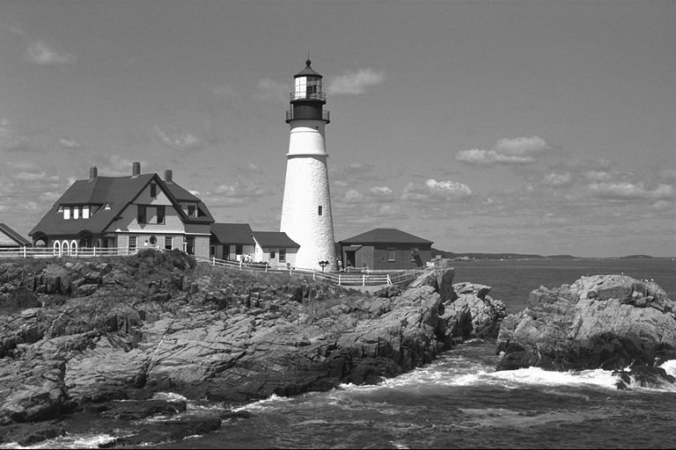
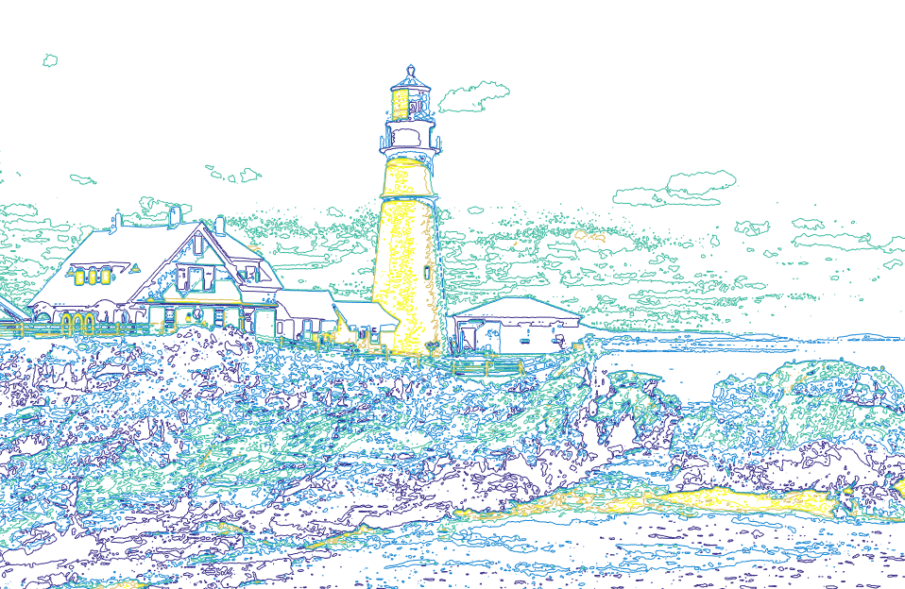
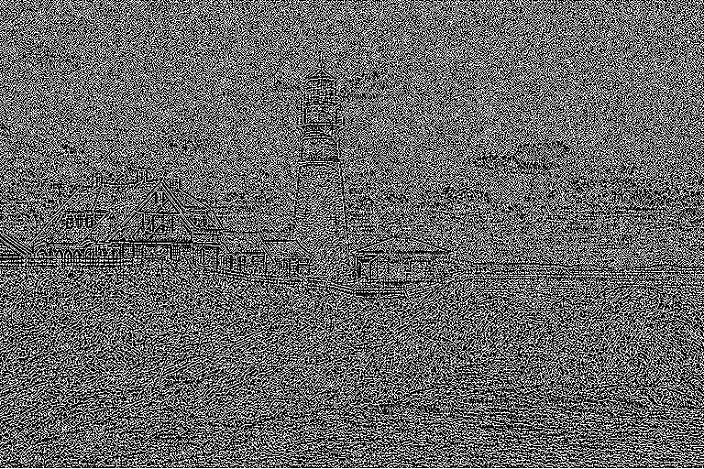
Why Curvature?
Original
It was shown by Levine and Bertalmío that when an image is corrupted by noise, the curvature image is less effected by it
An image can be perfectly reconstructed from its level lines
Level lines
Curvature
Surface
Notes:
One of the reasons that we are considering curvature denoising is because the curvature image is less effected by noise than the image itself
The other reason we are considering curvature is because a surface can be perfectly reconstructed from its level sets and if we view an image as a surface we can image that it, too, can be perfectly reconstructed

Slide 11
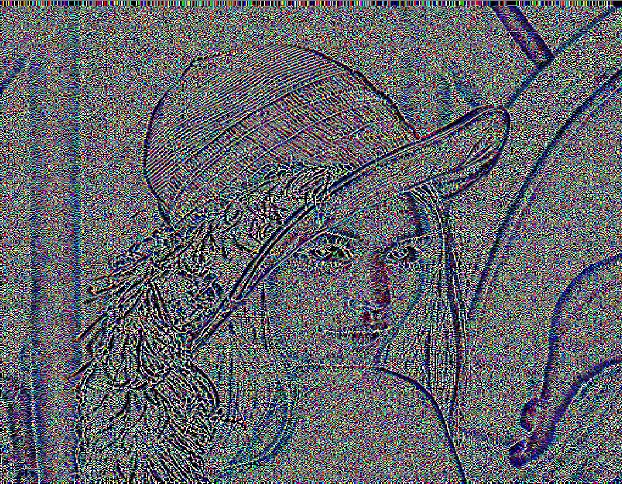
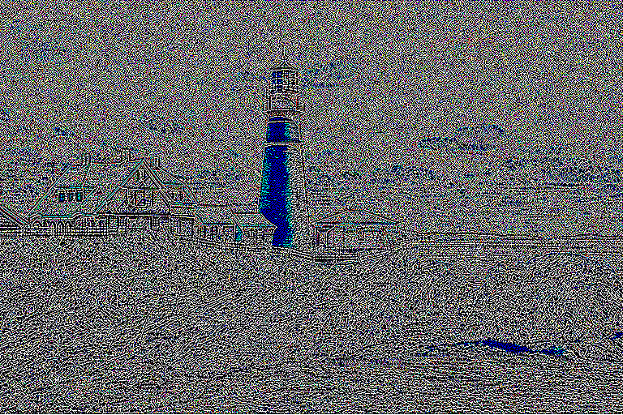
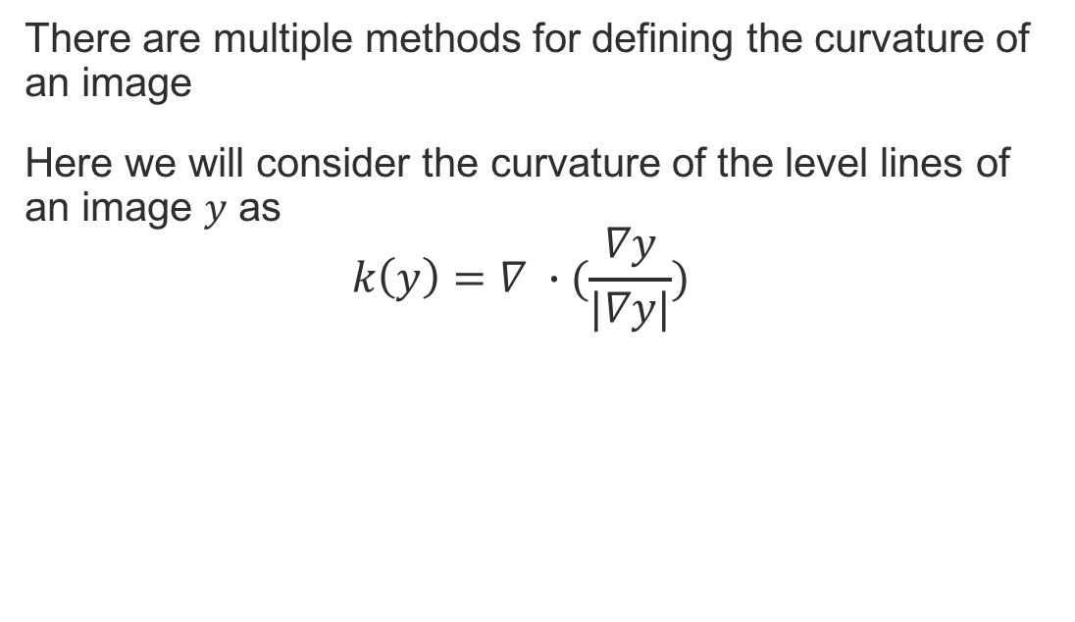
Computing Image Curvature
There are multiple methods for defining the curvature of an image
Here we will consider the curvature of the level lines of an image $y$ as
$$k\left(y\right)=∇ ∙(\frac{∇y}{|∇y|})$$
Notes:
This definition of curvature is the one you typically see in a calc3 class
The fractional term is the unit normal vectors to the level lines of the image (the level lines are just pixels with the same intensity value)
When you take the gradient of this (which is really the divergence of the vector field of unit normals of the level lines) you get the change in the unit normal vectors or curvature

Slide 12
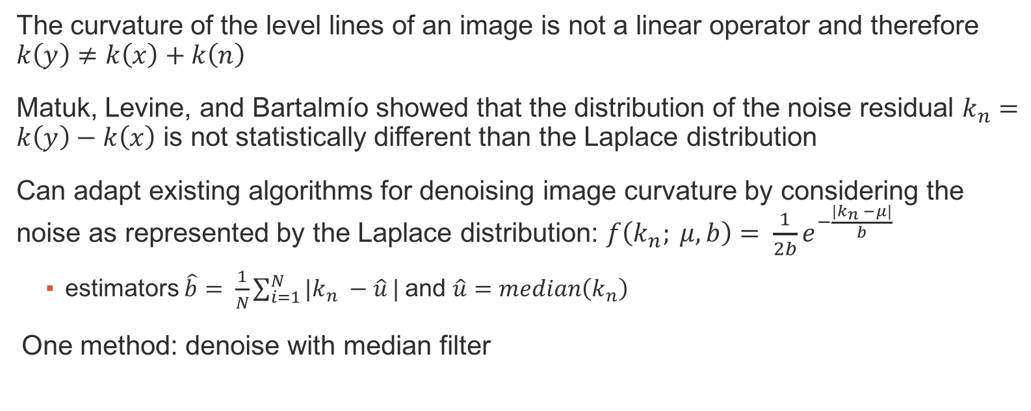
Denoising Image Curvature
The curvature of the level lines of an image is not a linear operator and therefore $k\left(y\right)≠k\left(x\right)+k\left(n\right)$
Matuk, Levine, and Bartalmío showed that the distribution of the noise residual $k_{n}=k\left(y\right)−k\left(x\right)$ is not statistically different than the Laplace distribution
Can adapt existing algorithms for denoising image curvature by considering the noise as represented by the Laplace distribution: $f\left(k_{n}; μ, b\right)= \frac{1}{2b}e^{−\frac{|k_{n} −μ|}{b}}$
estimators $\hat{b}= \frac{1}{N}\sum_{i=1}^{N}{{|k}_{n} −\hat{u}}|$ and $\hat{u}=median\left(k_{n}\right)$
One method: denoise with median filter
Notes:
We don’t have time to talk about the details of denoising image curvature but there a few a few important facts that we need to know about so that we can attempt to answer our proposed question
(read slide)
One method for denoising image curvature that works well because of the laplace distribution of the noise is the median filter
The median filter just replaces each pixel with the median of its neighbors

Slide 13
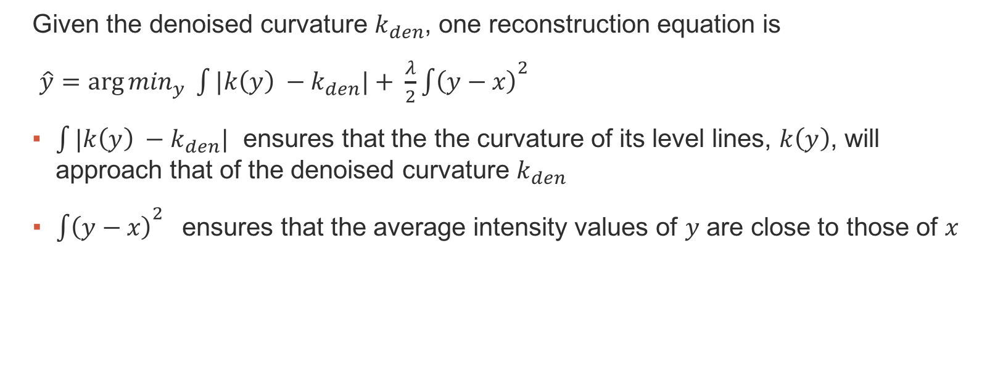
Image Reconstruction
Given the denoised curvature $k_{den}$, one reconstruction equation is
$\hat{y}=\arg{\min_{y}} \int{|k\left(y\right) −k_{den}|}+ \frac{λ}{2}{\int{\left(y−x\right)}}^{2}$
$\int{|k\left(y\right) −k_{den}|}$ ensures that the the curvature of its level lines, $k\left(y\right)$, will approach that of the denoised curvature $k_{den}$
${\int{\left(y−x\right)}}^{2}$ ensures that the average intensity values of $y$ are close to those of $x$
Notes:
Now that we’ve denoised the curvature image, how do we get back the original image?
(read slide – emphasize the basic idea with the two bullet points)

Slide 14
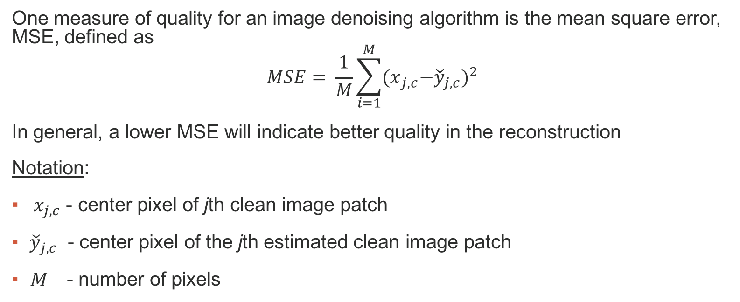
Metrics for Image Quality
One measure of quality for an image denoising algorithm is the mean square error, MSE, defined as
$$MSE= \frac{1}{M}\sum_{i=1}^{M}{{{(x}_{j,c}−{\check{y}}_{j,c})}^{2}}$$
In general, a lower MSE will indicate better quality in the reconstruction
Notation:
${ x}_{j,c}$ - center pixel of jth clean image patch
${\check{y}}_{j,c}$ - center pixel of the jth estimated clean image patch
M - number of pixels
Notes:
MSE measures the average of the squares of the errors between the clean image and the reconstructed image

Slide 15
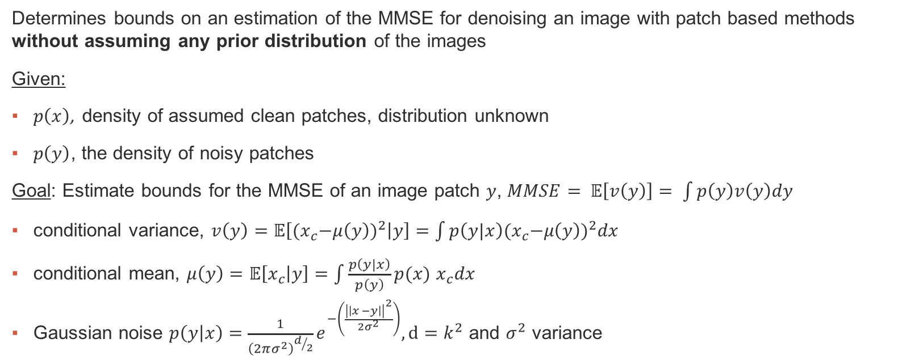
Framework for Bounding Natural Image Denoising
Determines bounds on an estimation of the MMSE for denoising an image with patch based methods without assuming any prior distribution of the images
Given:
$p\left(x\right)$, density of assumed clean patches, distribution unknown
$p\left(y\right)$, the density of noisy patches
Goal: Estimate bounds for the MMSE of an image patch $y$, $MMSE= 𝔼\left[v\left(y\right)\right]= \int{p\left(y\right)v\left(y\right)dy}$
conditional variance, $v\left(y\right)=𝔼\left[{{(x}_{c}−μ\left(y\right))}^{2} | y\right]=\int{p\left(y|x\right){{(x}_{c}−μ\left(y\right))}^{2}dx}$
conditional mean, $μ\left(y\right)=$ $𝔼\left[x_{c} | y\right]=\int{\frac{p\left(y|x\right)}{p\left(y\right)}}p(x)$ $x_{c}dx$
Gaussian noise $p\left(y | x\right)=\frac{1}{{\left(2πσ^{2}\right)}^{d/2}}e^{−\left(\frac{{\left|\left|x −y\right|\right|}^{2}}{2σ^{2}}\right)}, d=k^{2}$ and $σ^{2}$ variance
Notes:
With all of the previous information we are ready to talk about levin and nadlers framework
Their framework Determines bounds on an estimation of the MMSE for denoising an image with patch based methods without assuming any prior distribution of the images
Their goal was to estimate upper and lower bounds for the minimum mean square error or MMSE (which is a lower bound on the MSE)
Here the conditional mean is the Bayesian MMSE error estimate
And the conditional variance is the MMSE at any fixed y
If you find the expected value of the conditional variance you have the overal MMSE
The theoretical MMSE here is the lowest possible denoising error by any denoising algorithm

Slide 16
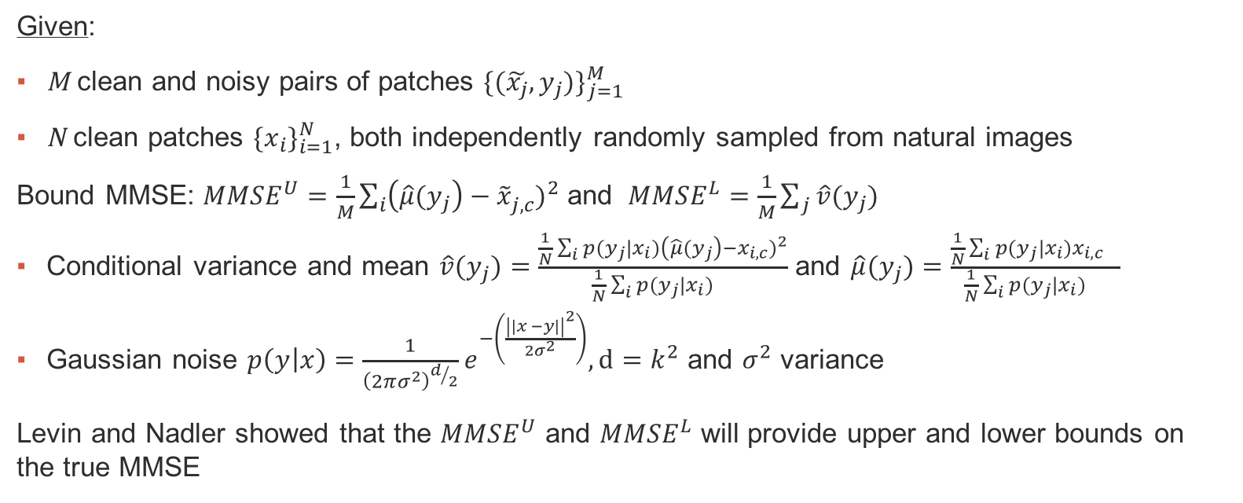
Framework for Bounding Natural Image Denoising
Given:
M clean and noisy pairs of patches ${\{(\tilde{x_{j}}, y_{j})\}}_{j=1}^{M}$
N clean patches ${\{x_{i}\}}_{i=1}^{N}$, both independently randomly sampled from natural images
Bound MMSE: ${MMSE}^{U}=\frac{1}{M}\sum_{i}{{\left({\hat{μ}(y}_{j}\right)−{\tilde{x}}_{j,c}^{})}^{2}}$ and ${MMSE}^{L}=\frac{1}{M}\sum_{j}{{\hat{v}(y}_{j})}$
Conditional variance and mean ${\hat{v}(y}_{j})=\frac{\frac{1}{N}\sum_{i}{{p(y_{j}|x_{i})\left({\hat{μ}(y}_{j}\right)−x_{i,c})}^{2}}}{\frac{1}{N}\sum_{i}{{p(y_{j}|x_{i}) }^{}}}$ and ${\hat{μ}(y}_{j})=\frac{\frac{1}{N}\sum_{i}{{p(y_{j}|x_{i})x_{i,c}}^{}}}{\frac{1}{N}\sum_{i}{{p(y_{j}|x_{i}) }^{}}}$
Gaussian noise $p\left(y | x\right)=\frac{1}{{\left(2πσ^{2}\right)}^{d/2}}e^{−\left(\frac{{\left|\left|x −y\right|\right|}^{2}}{2σ^{2}}\right)}, d=k^{2}$ and $σ^{2}$ variance
Levin and Nadler showed that the ${MMSE}^{U}$ and ${MMSE}^{L}$ will provide upper and lower bounds on the true MMSE
Notes:
Now that we have the theory, we can talk about approximated it with upper and lower bounds
Given 2 sets of images:
We can bound the MMSE using these two formulas
With the conditional mean and variance defined here
Note that they are assuming that the noise is distributed like a Gaussian as we discussed before
Note that levin and nadler were able to show that the MMSE uppper and MMSE lower will provide upper and lower bounds on the true exact MMSE

Slide 17
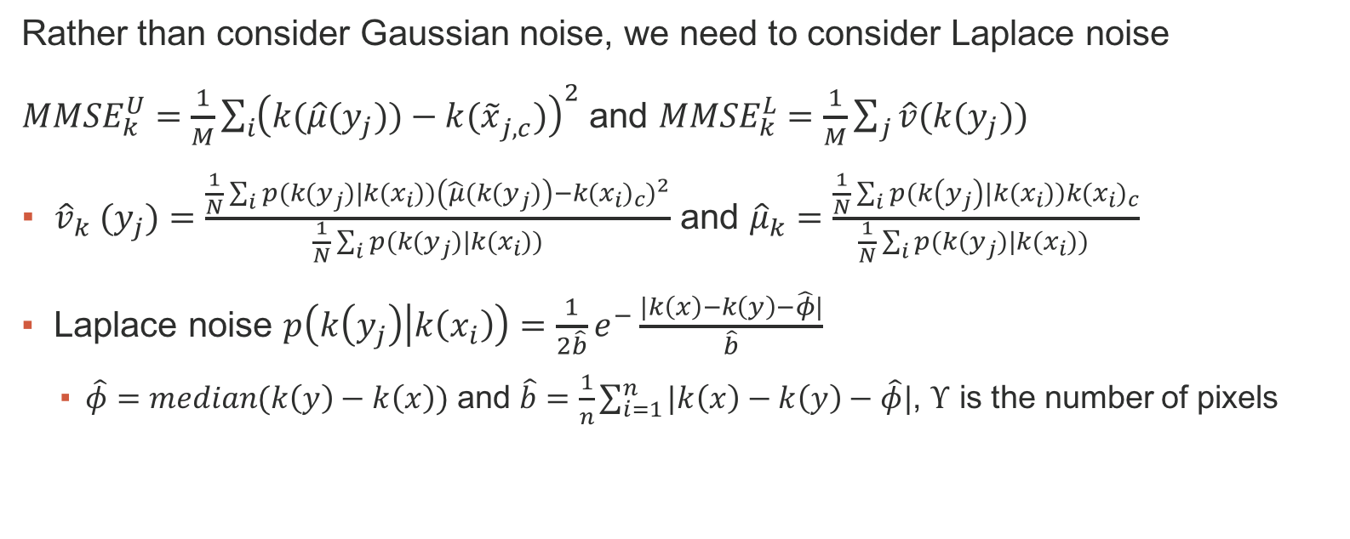
Proposed Framework for Bounding Curvature Denoising
Rather than consider Gaussian noise, we need to consider Laplace noise
${MMSE}_{k}^{U}=\frac{1}{M}\sum_{i}{{\left({k(\hat{μ}(y}_{j}))−{k(\tilde{x}}_{j,c}^{})\right)}^{2}}$ and ${MMSE}_{k}^{L}=\frac{1}{M}\sum_{j}{{\hat{v}(k(y}_{j}))}$
${{\hat{v}}_{k} (y}_{j})=\frac{\frac{1}{N}\sum_{i}{{p(k(y_{j})|k(x_{i}))\left({\hat{μ}(k(y}_{j})\right)−{k(x_{i})}_{c})}^{2}}}{\frac{1}{N}\sum_{i}{{p(k(y_{j})|k(x_{i}))}^{}}}$ and ${\hat{μ}}_{k}=\frac{\frac{1}{N}\sum_{i}{p(k\left(y_{j}\right)|{k(x}_{i})){k(x_{i})}_{c}}}{\frac{1}{N}\sum_{i}{{p({k(y}_{j})|k(x_{i})) }^{}}}$
Laplace noise $p\left(k\left(y_{j}\right) | k\left(x_{i}\right)\right)=\frac{1}{2\hat{b}}e^{−}\frac{|k\left(x\right)−k\left(y\right)−\hat{φ}|}{\hat{b}}$
$\hat{φ}=median(k\left(y\right)−k\left(x\right))$ and $\hat{b}=\frac{1}{n}\sum_{i=1}^{n}{|k\left(x\right)−k\left(y\right)−\hat{φ}|}$, $Υ$ is the number of pixels
Notes:
Now, after all of that, we can talk about the current work which is attempting to answer that question we proposed way earlier
Here we have an adaptation of levin and nadlers framework that considers curvature image patches with an assumption of laplace noise
The goal is to use this framework to determine if the best achievable mmse for denoising curvature is better than that of patch based denoising algorithms

Slide 18
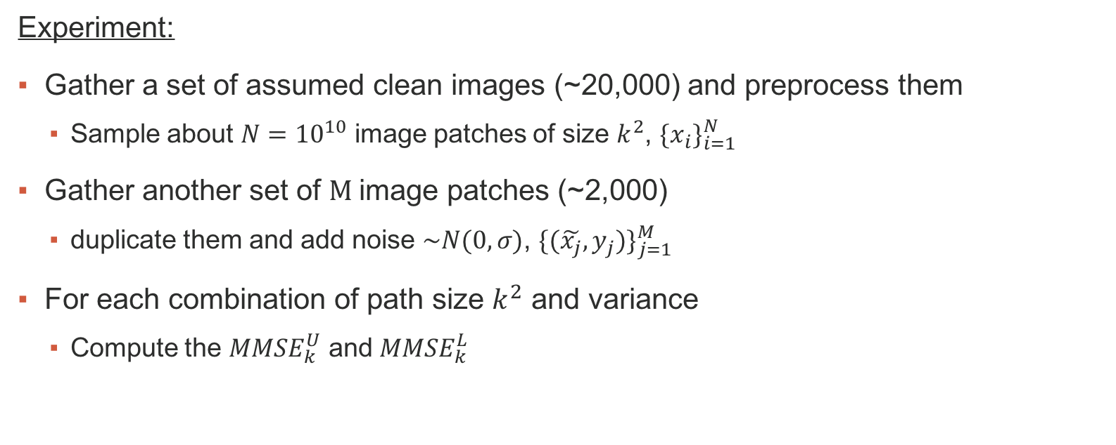
Proposed Framework for Bounding Curvature Denoising
Experiment:
Gather a set of assumed clean images (~20,000) and preprocess them
Sample about $N={10}^{10}$ image patches of size $k^{2}$, ${\{x_{i}\}}_{i=1}^{N}$
Gather another set of $M$image patches (~2,000)
duplicate them and add noise $\sim N(0,σ)$, ${\{(\tilde{x_{j}}, y_{j})\}}_{j=1}^{M}$
For each combination of path size $k^{2}$ and variance
Compute the ${MMSE}_{k}^{U}$ and ${MMSE}_{k}^{L}$
Notes:
This is the set up of actually using this framework to answer the research question

Slide 19
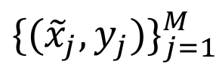
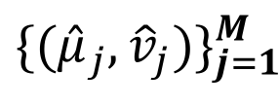
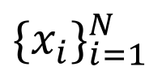
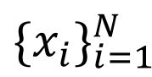
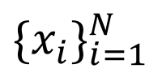
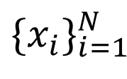

Proposed Framework for Bounding Curvature Denoising
Parallel Approach
Process
Local
Storage
Parallel Experiment:
Master Machine
MATLAB
$${\{x_{i}\}}_{i=1}^{N}$$
Input: $({\tilde{x}}_{j}, y_{j})$
-Condor Scheduler
-MATLAB
Output:$({\hat{μ}}_{j}, {\hat{v}}_{j})$
MATLAB
$${\{x_{i}\}}_{i=1}^{N}$$
MATLAB
$${\{x_{i}\}}_{i=1}^{N}$$
$${\{({\tilde{x}}_{j}, y_{j})\}}_{j=1}^{M}$$
Master Storage
$${\{({\hat{μ}}_{j}, {\hat{v}}_{j})\}}_{j=1}^{M}$$
MATLAB
$${\{x_{i}\}}_{i=1}^{N}$$
Notes:
This is the set up of actually using this framework to answer the research question

Slide 20
Challenges
Time Complexity
Sampling the 10^10 image patches is itself a challenge
Preliminary Results on small sample sizes took days on a single machine
Curvature data has pixel values in the range [-4,4] where as normal images are viewed between [0,255] or [0,1]. This causes some of the means to come out negative.
Bounds determined with small sample sizes were very large and emphasizes the need to parallelize the experiment.
Notes:
There are a few things that I have been thinking about while I have started to implement this framework
There are a ton of computational challenges related to performing this experiment.
pre processing data is tough: 10^10 sampeles is not trivial
Read and explain the slide

Slide 21
References
A. Levin and B. Nadler, “Natural image denoising: Optimality and inherent bounds,” in Computer Vision and Pattern Recognition (CVPR), 2011 IEEE Conference on. IEEE, 2011, pp. 2833–2840.
M. Bertalmío and S. Levine, Denoising an Image by Denoising Its Curvature Image, SIAM J. Imaging Sciences, Vol.7, pp. 187-211 (2014).
B. Russell, A. Torralba, K. Murphy, W. T. Freeman. LabelMe: A Database and Web-based Tool for Image Annotation. International Journal of Computer Vision, pages 157-173, Volume 77, Numbers 1-3, May, 2008.
J. Matuk, S. Levine, and M. Bertalmío, The Curvature Noise Distribution and Applications, 2016. In Review.
Notes:
Thank you everyone for being attentive
And thank you to my research advisor Dr. stacey levine and thank you to Dr. john kern for helpful discussions
feel free to ask any questions

